Slide 1
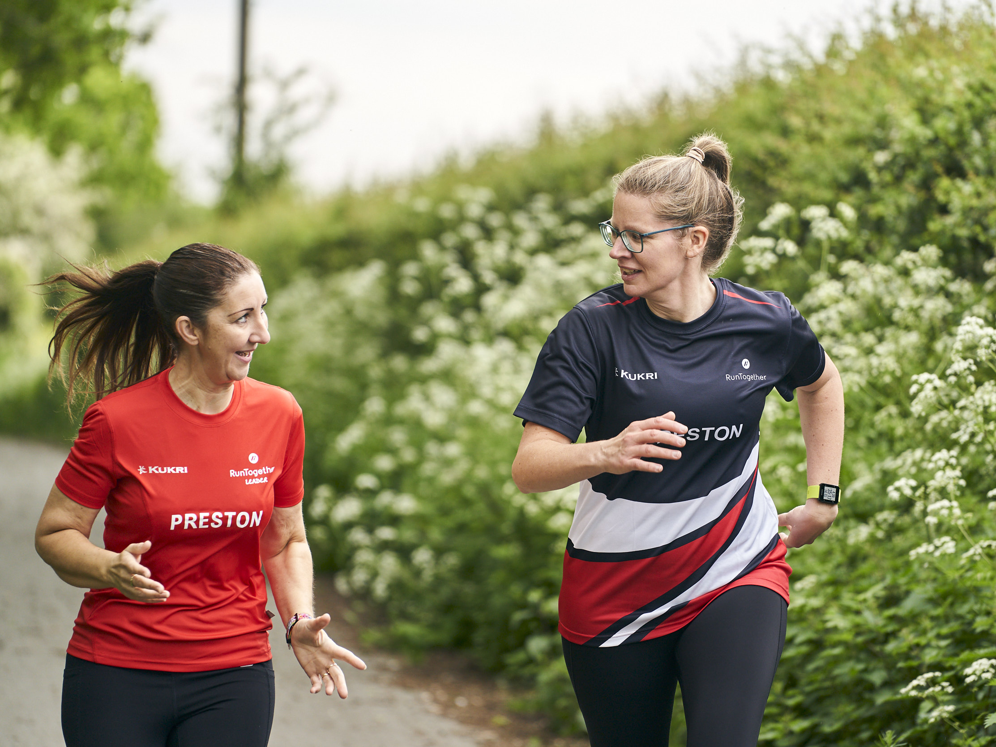

RunTogether Safeguarding

Slide 2







Welcome
For all questions, queries, comments please contact our support team @....
support@runtogether.co.uk
Join the conversation….
Facebook RunTogetherSocial
Twitter @RunTogether_
Instagram @RunTogether_
RunTogether Safeguarding
Introduce yourself in the chat, name, role and club
To prevent background please mute for presentation.
Its always nice to see smiley faces (use of camera is optional)
Use the chat box to ask questions
Make yourself comfortable and grab a refreshment
There maybe an opportunity to come off mute and ask questions

Slide 3
What is Safeguarding (Welfare & Wellbeing)
Understand what RunTogether groups should have in place for safeguarding. ​
Explore any potentials challenges that the group or leaders may have in relation to safeguarding and formulate an action plan to overcome them. ​
Understand how to access further support to help groups and leaders with safeguarding.

Slide 4
What is Safeguarding?
Notes:
Write in comments box, shout out what you think this is

Slide 5
What?
Safeguarding is the action that is taken to promote the welfare of children / young people and vulnerable adults (Policies, Procedures, Codes)
Welfare the good fortune, health, happiness, prosperity, etc., of a person, group, or organization; well-being: to look after a ‘child or young person / adults' welfare; the physical or moral welfare of society. (Culture)
Wellbeing the state of being comfortable, healthy, or happy (Mental Health Champions)
‘Duty of Care’ is a common law duty that applies to all individuals and organisations. ​
​
Everyone has a role to play in keeping others safe and all club members should know what to do if they have any concerns.​ (Culture)
Notes:
Write in comments box, shout out what you think this is

Slide 6
What are the six principles of safeguarding?
Empowerment. People being supported and encouraged to make their own decisions and informed consent.
Prevention. It is better to take action before harm occurs.
Proportionality. The least intrusive response appropriate to the risk presented.
Protection. ...
Partnership. ...
Accountability
bullying, radicalisation, sexual exploitation, grooming, allegations against staff, incidents of self-harm, forced marriage, and FGM
protecting the health, wellbeing and human rights of adults at risk
What is Safeguarding?
‘banter’
Stalking
Social media comments
Relationships breakdown
Money

Slide 7
​Understand what RunTogether groups should have in place for safeguarding

Slide 8
What do runners want to experience?
Welcomed and included
Be happy, make friends, enjoy being in the groups and feel part of it
Understand the way the group works and the opportunities I can take part in
Safeguarding is putting things in place to protect all of this
Improve and progress, and for this to be recognised
Feel safe and trust those in charge
Know who to speak to if I have a problem and have the trust that it will be dealt with fairly

Slide 9
What does Safeguarding look like?
Creating opportunities for members to give feedback and share ideas
Adopting and Sharing Policies and Procedures
Regular Communication with Runners
Safeguarding is putting things in place to protect all of this
Managing Concerns which may include reporting information
Safely Recruiting and Training Volunteers
Have a safe way for runners and volunteers to talk to someone
Notes:
Safe Recruitment – DBS, LIRF, inductions
Welfare officers – point of contact (training)
My Concern

Slide 10
Group Breakout
15 minutes to discuss the following within your group…..
What does your group already have in place
Could you face any challenges with implementation
What support might help you to overcome these

Slide 11
Group Feedback
3 things from this evening
What can you go away and think about or implement
Training
Codes
Welfare officer
Culture
Plan
??
Notes:
Write in comments box, shout out what you think this is

Slide 12
Further Support – your not alone
Staff – RunTogether Team, EA Staff, UKA staff - https://www.englandathletics.org/clubs-and-facilities/club-support-services/club-welfare/#contacts
Club Welfare and Safeguarding Resources https://www.englandathletics.org/resources/
UKA & HCAF Codes of Conduct – Leaders/ Coaches and Runner https://england-athletics-prod-assets-bucket.s3.amazonaws.com/2021/07/codes-of-conduct-booklet2021.pdf
Access the UK Athletics & HCAF Club Safeguarding code of conduct (for best practise) - https://www.englandathletics.org/resources/view/uk-athletics-hcaf-club-safeguarding-code-of-conduct/?from=1
Time to Listen Training - https://www.englandathletics.org/clubs-and-facilities/club-support-services/club-welfare/club-welfare-roles-responsibilities/
Reporting, Myconcern - https://www.uka.org.uk/submit-a-concern
Over the Coming Months the Leaders area of RunTogether will be update to help support Leaders and Groups with this area
Notes:
Think about adopting codes of conduct for your groups
Leaders training and codes of conduct
Under 16’s – officers

Slide 13




External support
External organisations that can also support
Notes:
https://thecpsu.org.uk/
https://www.uka.org.uk/governance/safeguarding_2021/
https://www.anncrafttrust.org/
https://www.mind.org.uk/

Slide 14

Questions

Slide 15
For all questions, queries, comments please contact our support team @....
support@runtogether.co.uk
Join the conversation….
Facebook RunTogetherSocial
Twitter @RunTogether_
Instagram @RunTogether_

